Slide 1
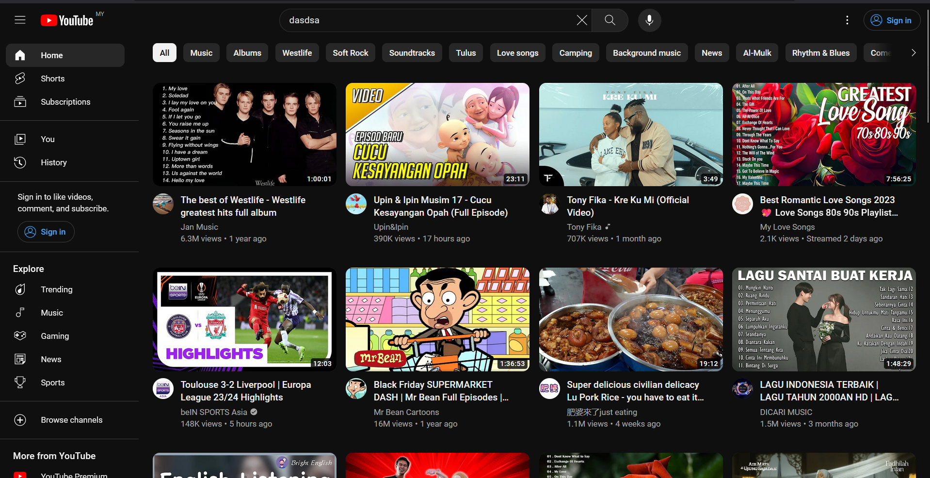
Layout
1
3
2
4

Slide 2
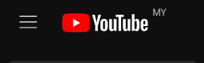

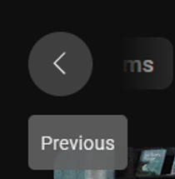
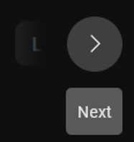
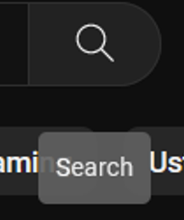
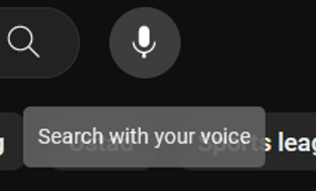
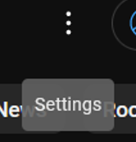

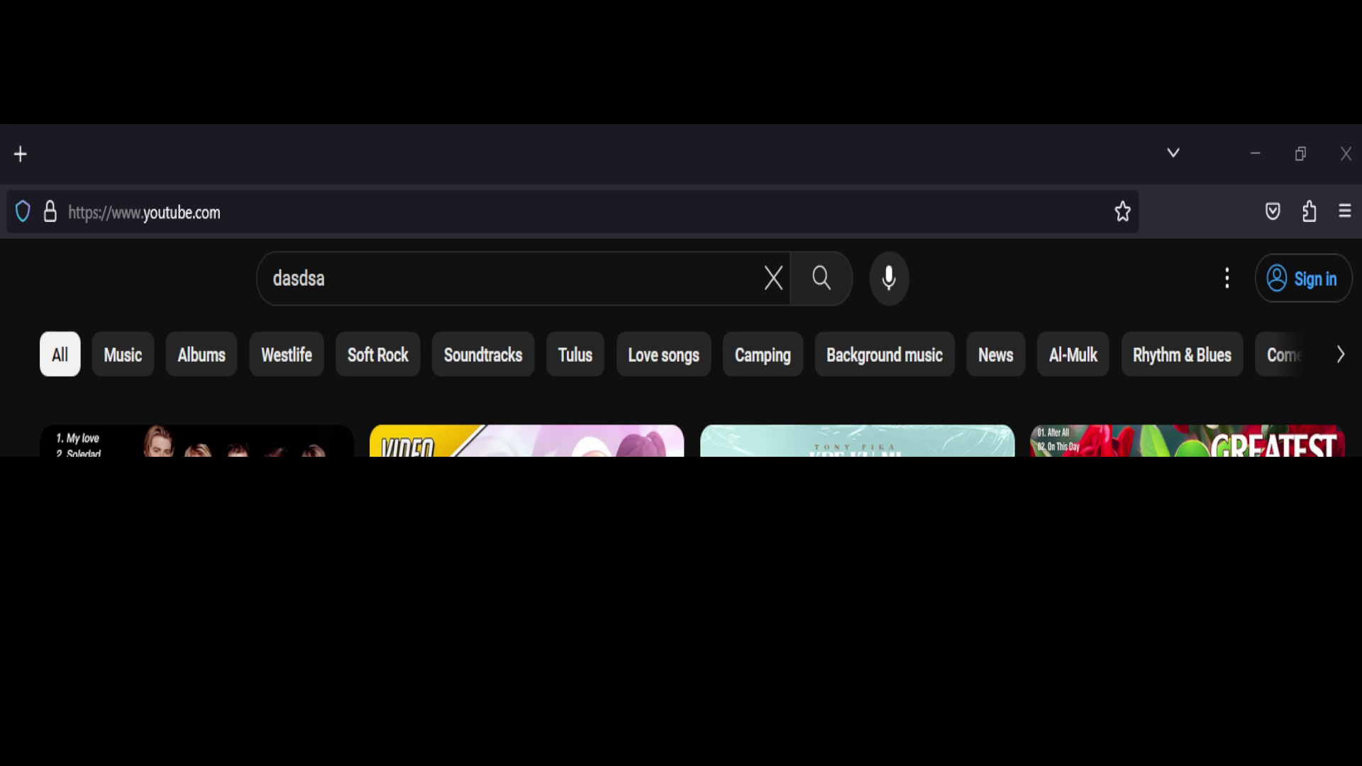
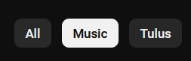


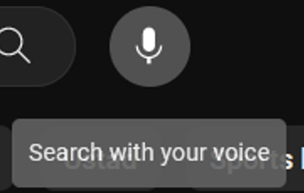
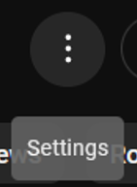

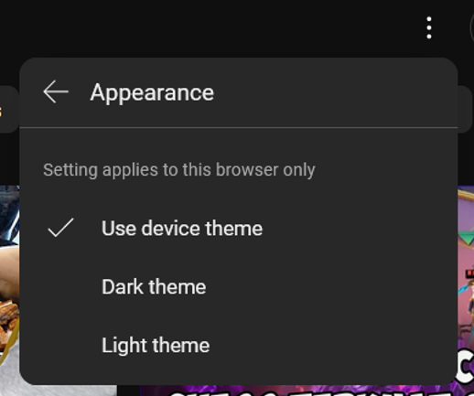
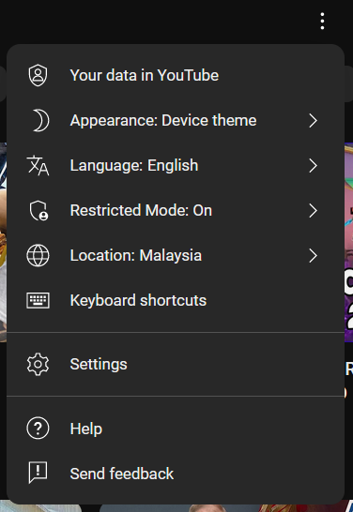
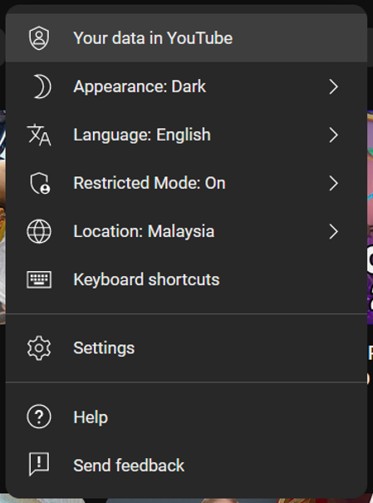
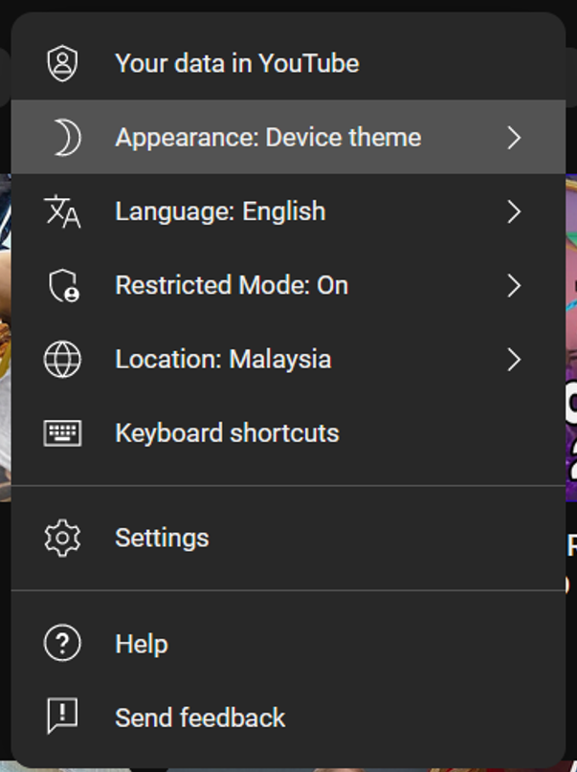
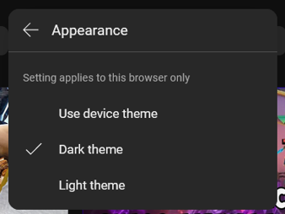
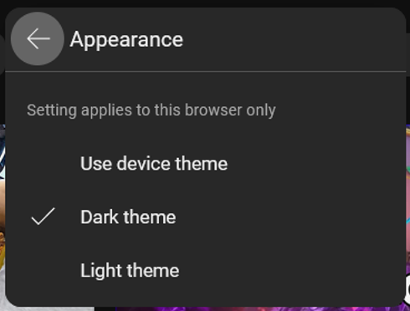


Header / Sub-header
Hover Effect ---------------------------------------------------------------------------------------------------------------------------------------------------------------------------------------------------
Edge fade away
Show Selection ---------------------------------------------------------------------------------------------------------------------------------------------------------------------------------------
Max: 546 x 40px
Deselect
Click Effect -----------------------------------------------------------------------------------------------------------------------------------------------------------------------------------------------
Except, these, No effect
All button
Prompt Menu -----------------------------------------------------------------------------------------------------------------------------------------------------------------------------------------------
Click effect

Slide 3
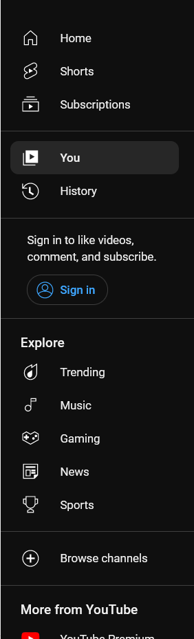
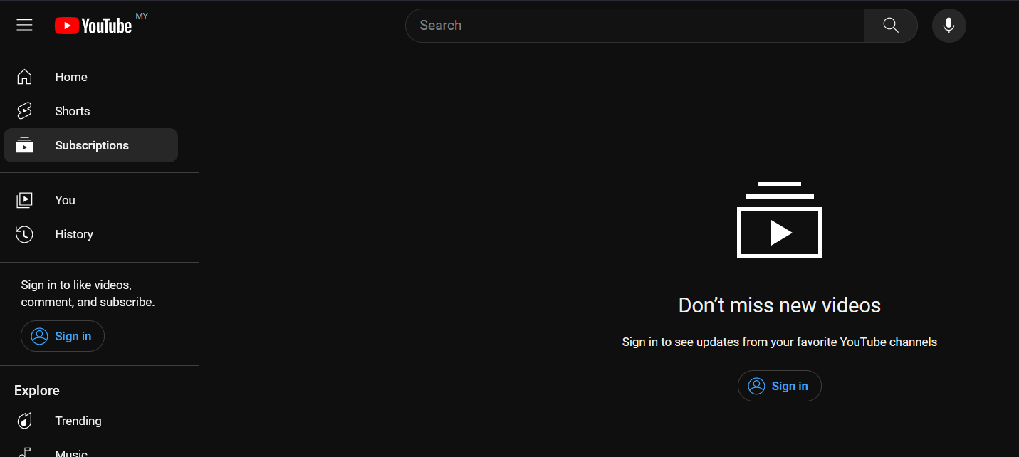
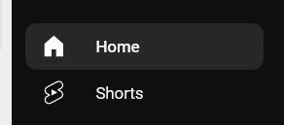
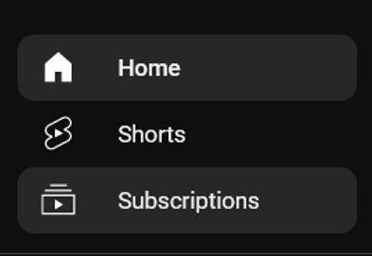
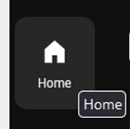

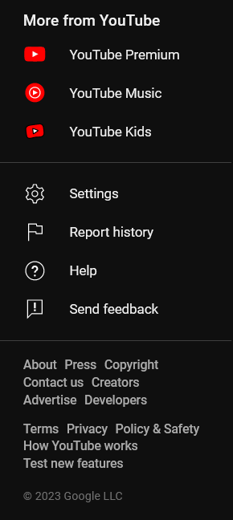
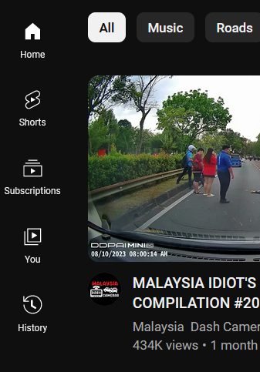
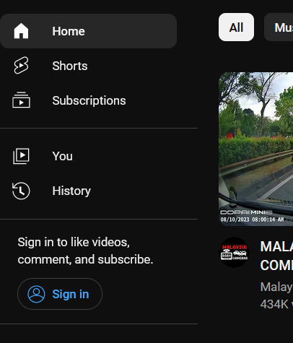
Side bar
Show Selection ---------------------------------------------------------------------------------------------------------------------------------------------------------------------------------------
Change content
Hover Effect ---------------------------------------------------------------------------------------------------------------------------------------------------------------------------------------
Click Effect ---------------------------------------------------------------------------------------------------------------------------------------------------------------------------------------
Mini version

Slide 4






Content
Hover Effect ---------------------------------------------------------------------------------------------------------------------------------------------------------------------------------------

Slide 5

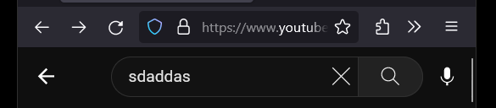
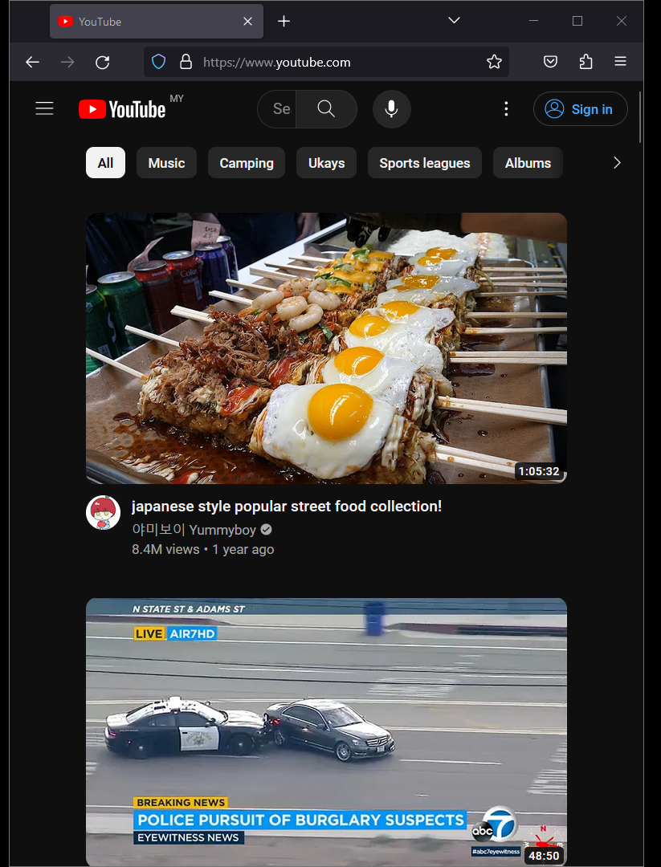
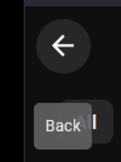
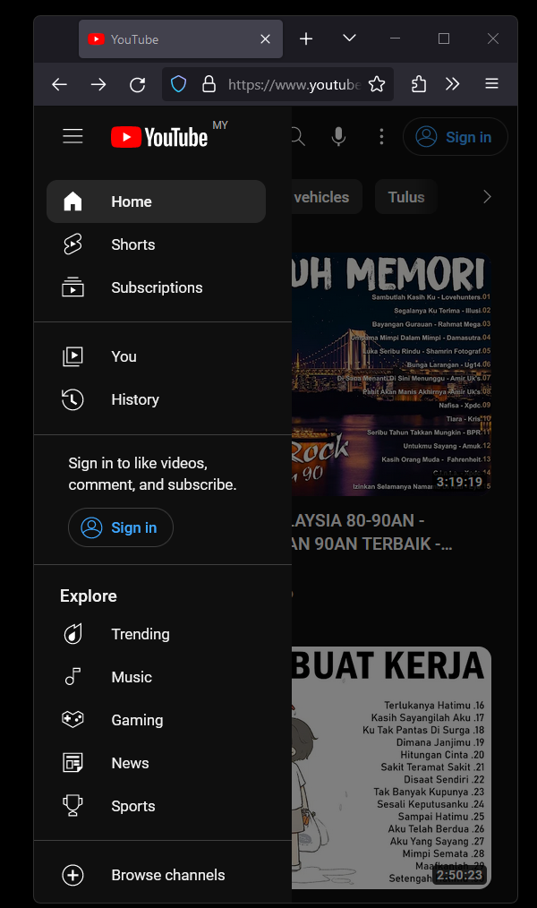


Responsive design - Smallest (450px - 690px)
Revert back to normal if deselect
Search bar pop-up (650 px)
Overlap and content section greyed out

Slide 6
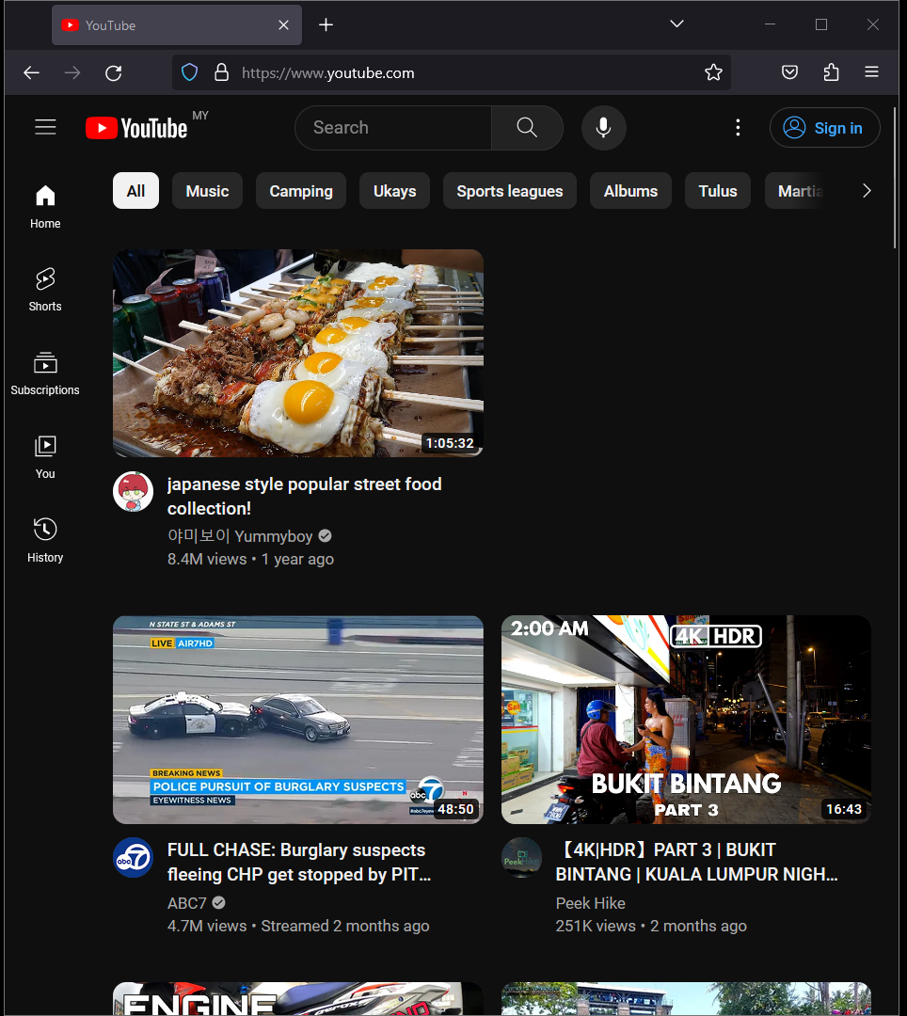


Responsive design - Middle (690px - 1080px)
Side bar only appear after 790px

Slide 7
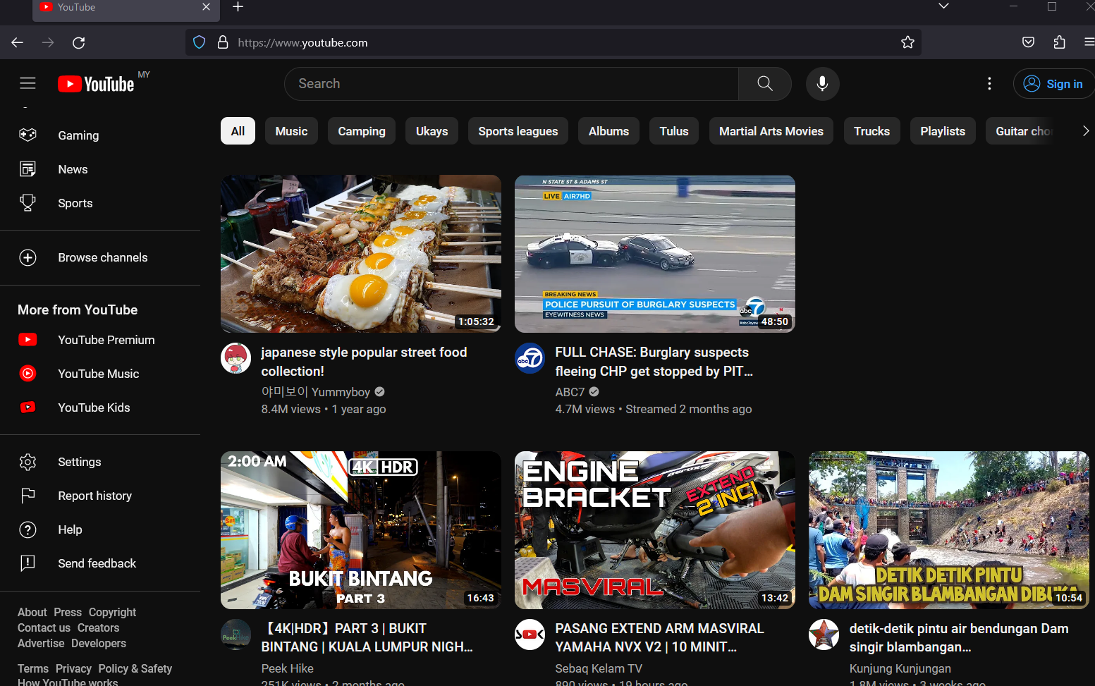


Responsive design - Laptop (1080px -1600px )
Sidebar expand after 1300px

Slide 8
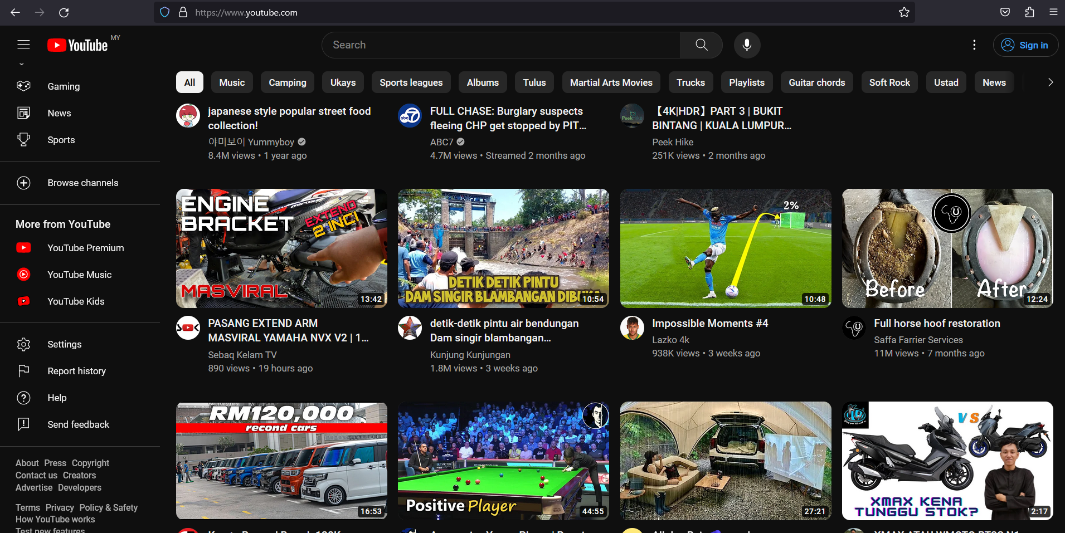
Responsive design - Monitor (1080px - 1600px)

